Slide 1
CSE477
VLSI Digital Circuits
Fall 2002
Lecture 02: Design Metrics
Mary Jane Irwin ( www.cse.psu.edu/~mji ) www.cse.psu.edu/~cg477
[Adapted from Rabaey’s Digital Integrated Circuits, ©2002, J. Rabaey et al.]
Notes:
Other handouts
Course schedule with due dates
HW#1
Project Description

Slide 2
Course Administration
Instructor: Mary Jane Irwin mji@cse.psu.edu www.cse.psu.edu/~mji 227 Pond Lab Office Hrs: M 13:30-14:45 & R 9:30-10:45
TA: Vijay Degalahal (and Greg Link) degalaha@cse.psu.edu (link@cse.psu.edu ) 225 Pond Lab (226 Pond Lab) Office Hrs: W & R 17:30 to 19:30 in 101 Pond
Labs: Accounts on 101 Pond Lab machines
URL: www.cse.psu.edu/~cg477
Text: Digital Integrated Circuits, 2nd Edition Rabaey et. al., ©2002 (October)
Handouts: Leftover handouts available outside my office door after class
Notes:
computer accounts are automatic, if have never had an account in CSE I will have (or soon have) a listing of userids/passwords.
seating chart – assignment for Thursday – xerox copy of your photo ID
pick a seat for the semester and sit there (or nearby) for rest of semester
room size -

Slide 3
Grading Information
Grade determinates
  Midterm Exam ~25%
    Wednesday, October 16th , 20:15 to 22:15, 260 Willard
  Final Exam ~25%
    Monday, December 16th, 10:10 to noon, Location TBD
  Homeworks/Lab Assignments (5) ~20%
    Due at the beginning of class (or, if submitted electronically, by 17:00 on the due date). No late assignments will be accepted.
  Design Project (teams of ~2) ~25%
  In-class pop quizzes ~ 5%
Please let me know about exam conflicts ASAP
Grades will be posted on the course homepage
  December 10th deadline for filing grade updates via email
Notes:
Note: evening midterm exam
Design intensive class – with semester design project

Slide 4
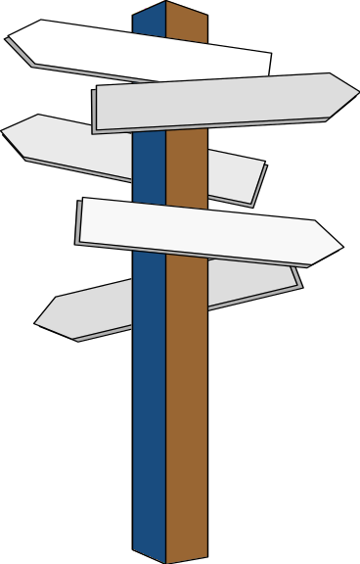
Major Design Challenges
Microscopic issues
  ultra-high speeds
  power dissipation and supply rail drop
  growing importance of interconnect
  noise, crosstalk
  reliability, manufacturability
  clock distribution
Macroscopic issues
  time-to-market
  design complexity (millions of gates)
  high levels of abstractions
  design for test
  reuse and IP, portability
  systems on a chip (SoC)
  tool interoperability
Year | Tech. | Complexity | Frequency | 3 Yr. Design Staff Size | Staff Costs
1997 | 0.35 | 13 M Tr. | 400 MHz | 210 | $90 M
1998 | 0.25 | 20 M Tr. | 500 MHz | 270 | $120 M
1999 | 0.18 | 32 M Tr. | 600 MHz | 360 | $160 M
2002 | 0.13 | 130 M Tr. | 800 MHz | 800 | $360 M
Notes:
Staffing costs computed at $150K/staff year (in 1997 dollars)

Slide 5
Overview of Last Lecture
Digital integrated circuits experience exponential growth in complexity (Moore’s law) and performance
Design in the deep submicron (DSM) era creates new challenges
  Devices become somewhat different
  Global clocking becomes more challenging
  Interconnect effects play a more significant role
  Power dissipation may be the limiting factor
Our goal in this class will be to understand and design digital integrated circuits in the deep submicron era
Today we look at some basic design metrics

Slide 6
Fundamental Design Metrics
Functionality
Cost
  NRE (fixed) costs - design effort
  RE (variable) costs - cost of parts, assembly, test
Reliability, robustness
  Noise margins
  Noise immunity
Performance
  Speed (delay)
  Power consumption; energy
Time-to-market
Notes:
RE costs - silicon processing, packaging, test
proportional to product volume and chip area
NRE - non recurring engineering - one time cost factor
design time and effort, mask generation

Slide 7
Cost of Integrated Circuits
NRE (non-recurring engineering) costs
  Fixed cost to produce the design
    design effort
    design verification effort
    mask generation
  Influenced by the design complexity and designer productivity
  More pronounced for small volume products
Recurring costs – proportional to product volume
  silicon processing
    also proportional to chip area
  assembly (packaging)
  test
  fixed cost
  cost per IC = variable cost per IC + -----------------
  volume
Notes:
Larger fixed cost for small volume parts explains why it makes sense to have large design teams working for several years on a hugely successful product (like a microprocessor)

Slide 8
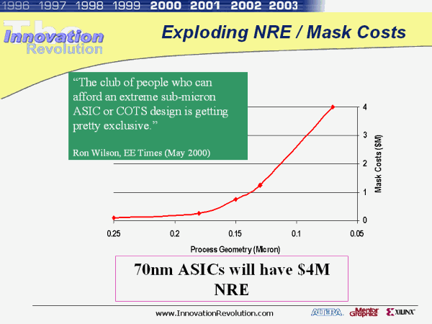
NRE Cost is Increasing

Slide 9
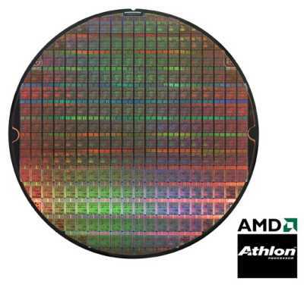
Silicon Wafer
Single die
Wafer
From http://www.amd.com

Slide 10
Recurring Costs
  cost of die + cost of die test + cost of packaging
  variable cost = ----------------------------------------------------------------
  final test yield
  cost of wafer
  cost of die = -----------------------------------
  dies per wafer × die yield
  π × (wafer diameter/2)² π × wafer diameter
  dies per wafer = ---------------------------------- − ---------------------------
  die area √ 2 × die area
  die yield = (1 + (defects per unit area × die area)/α)^{-α}
Notes:
While the cost of producing a single transistor has dropped exponentially over the past few decades, the basic cost equation hasn’t changed.
Cost of a circuit is dependent upon the chip area.
Alpha depends upon the complexity of the manufacturing process (and is roughly proportional to the number of masks). A good estimate for today’s complex CMOS process is alpha = 3.
Defects per unit area is a measure of the material and process-induced faults. A value between 0.5 and 1 defects/cm**2 is typical today but strongly depends upon the maturity of the process.

Slide 11
Yield Example
Example
  wafer size of 12 inches, die size of 2.5 cm², 1 defects/cm², α = 3 (measure of manufacturing process complexity)
  252 dies/wafer (remember, wafers round & dies square)
  die yield of 16%
  252 x 16% = only 40 dies/wafer die yield !
Die cost is strong function of die area
  proportional to the third or fourth power of the die area
Notes:
While the cost of producing a single transistor has dropped exponentially over the past few decades, the basic cost equation hasn’t changed.
Cost of a circuit is dependent upon the chip area.
Alpha depends upon the complexity of the manufacturing process (and is roughly proportional to the number of masks). A good estimate for today’s complex CMOS process is alpha = 3.
Defects per unit area is a measure of the material and process-induced faults. A value between 0.5 and 1 defects/cm**2 is typical today but strongly depends upon the maturity of the process.

Slide 12
Examples of Cost Metrics (1994)
Chip | Metal layers | Line width | Wafer cost | Defects/cm² | Area (mm²) | Dies/wafer | Yield | Die cost
386DX | 2 | 0.90 | $900 | 1.0 | 43 | 360 | 71% | $4
486DX2 | 3 | 0.80 | $1200 | 1.0 | 81 | 181 | 54% | $12
PowerPC 601 | 4 | 0.80 | $1700 | 1.3 | 121 | 115 | 28% | $53
HP PA 7100 | 3 | 0.80 | $1300 | 1.0 | 196 | 66 | 27% | $73
DEC Alpha | 3 | 0.70 | $1500 | 1.2 | 234 | 53 | 19% | $149
Super SPARC | 3 | 0.70 | $1700 | 1.6 | 256 | 48 | 13% | $272
Pentium | 3 | 0.80 | $1500 | 1.5 | 296 | 40 | 9% | $417

Slide 13
Reliability
Noise in Digital Integrated Circuits
Noise – unwanted variations of voltages and currents at the logic nodes
from two wires placed side by side
  capacitive coupling
    voltage change on one wire can influence signal on the neighboring wire
    cross talk
  inductive coupling
    current change on one wire can influence signal on the neighboring wire
v(t)
i(t)
V_{DD}
from noise on the power and ground supply rails
  can influence signal levels in the gate

Slide 14
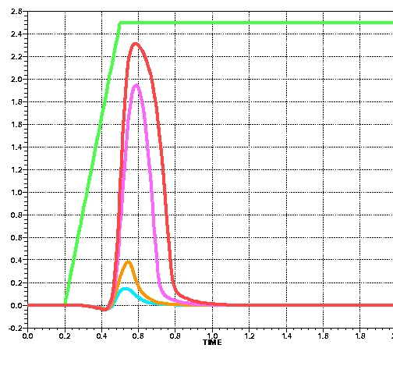
Example of Capacitive Coupling
Signal wire glitches as large as 80% of the supply voltage will be common due to crosstalk between neighboring wires as feature sizes continue to scale
Crosstalk vs. Technology
Pulsed Signal
0.12m CMOS
0.16m CMOS
Black line quiet
Red lines pulsed
0.25m CMOS
Glitches strength vs technology
0.35m CMOS
From Dunlop, Lucent, 2000

Slide 15
Static Gate Behavior
Steady-state parameters of a gate – static behavior – tell how robust a circuit is with respect to both variations in the manufacturing process and to noise disturbances.
Digital circuits perform operations on Boolean variables x ∈{0,1}
A logical variable is associated with a nominal voltage level for each logic state
  1 ⇔ V_{OH} and 0 ⇔ V_{OL}
V_{OH} = ! (V_{OL})
V(x)
V(y)
V_{OL} = ! (V_{OH})
Difference between V_{OH} and V_{OL} is the logic or signal swing V_{sw}

Slide 16
DC Operation
Voltage Transfer Characteristics (VTC)
Plot of output voltage as a function of the input voltage
V(y)
V(x)
V(y)
V_{OH} = f (V_{IL})
f
V(y)=V(x)
V_{M}
Switching Threshold
V_{OL} = f (V_{IH})
V_{IL}
V_{IH}
V(x)
Notes:
VM is the intersection of the VTC curve and the line given by Vout = Vin

Slide 17
Mapping Logic Levels to the Voltage Domain
The regions of acceptable high and low voltages are delimited by V_{IH} and V_{IL} that represent the points on the VTC curve where the gain = -1
V(y)
"1"
V_{OH}
Slope = -1
V_{OH}
V_{IH}
Undefined
Region
V_{IL}
Slope = -1
V_{OL}
"0"
V_{OL}
V_{IL}
V_{IH}
V(x)
Notes:
Slope = -1 are unity gain points

Slide 18
Noise Margins
For robust circuits, want the “0” and “1” intervals to be a s large as possible
V_{DD}
V_{DD}
V_{OH}
"1"
NM_{H} = V_{OH} - V_{IH}
V_{IH}
Noise Margin High
Undefined
Region
Noise Margin Low
V_{IL}
NM_{L} = V_{IL} - V_{OL}
V_{OL}
"0"
Gnd
Gnd
Gate Output
Gate Input
Large noise margins are desirable, but not sufficient …
Notes:
model is Gate Output of inverter1 feeding Gate Input of inverter2
Noise margin represents the levels of noise that can be sustained when gates are cascaded – obviously noise margins should be as large as possible

Slide 19
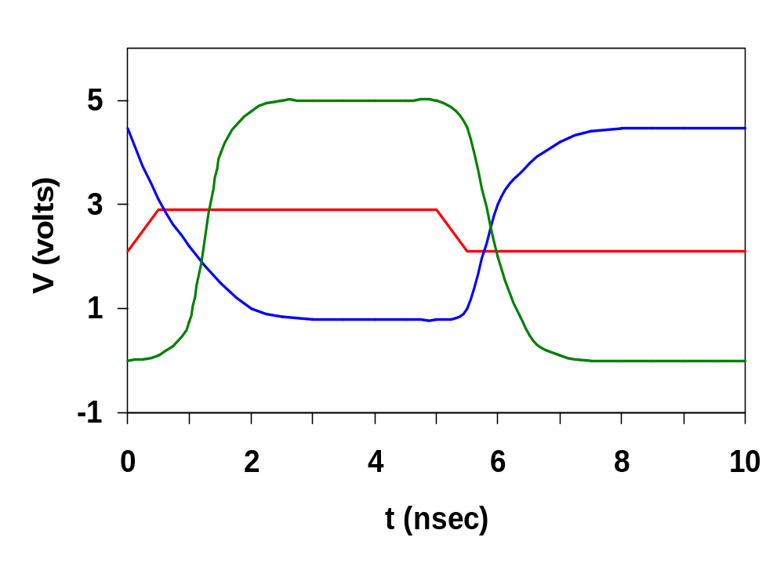
The Regenerative Property
A gate with regenerative property ensure that a disturbed signal converges back to a nominal voltage level
v₀
v₁
v₂
v₃
v₄
v₅
v₆
v₂
v₀
v₁
Notes:
Ensures that a disturbed signal will eventually converge back to one of the nominal levels
Vo only extends between 1.1V and 1.4V; v1 from 0.3V to 2.25V and v2 between nominal VOL and VOH

Slide 20
Conditions for Regeneration
v₀
v₁
v₂
v₃
v₄
v₅
v₆
v₁ = f(v₀) ⇒ v₁ = finv(v₂)
v₃
f(v)
finv(v)
v₁
v₁
v₃
finv(v)
f(v)
v₂
v₀
v₀
v₂
Regenerative Gate
Nonregenerative Gate
To be regenerative, the VTC must have a transient region with a gain greater than 1 (in absolute value) bordered by two valid zones where the gain is smaller than 1. Such a gate has two stable operating points.

Slide 21
Noise Immunity
Noise margin expresses the ability of a circuit to overpower a noise source
  noise sources: supply noise, cross talk, interference, offset
Absolute noise margin values are deceptive
  a floating node is more easily disturbed than a node driven by a low impedance (in terms of voltage)
Noise immunity expresses the ability of the system to process and transmit information correctly in the presence of noise
For good noise immunity, the signal swing (i.e., the difference between V_{OH} and V_{OL}) and the noise margin have to be large enough to overpower the impact of fixed sources of noise
Notes:
IMPEDANCE – (not inductance!!)
Want output impedance of the driver to be zero ideally
Input impedance of the receiver to be infinity ideally
The two together give unlimited fanout

Slide 22
Directivity
A gate must be undirectional: changes in an output level should not appear at any unchanging input of the same circuit
  In real circuits full directivity is an illusion (e.g., due to capacitive coupling between inputs and outputs)
Key metrics: output impedance of the driver and input impedance of the receiver
  ideally, the output impedance of the driver should be zero
  input impedance of the receiver should be infinity
Notes:
IMPEDANCE – (not inductance!!)
Want output impedance of the driver to be zero ideally
Input impedance of the receiver to be infinity ideally
The two together give unlimited fanout

Slide 23
Fan-In and Fan-Out
Fan-out – number of load gates connected to the output of the driving gate
  gates with large fan-out are slower
N
Fan-in – the number of inputs to the gate
  gates with large fan-in are bigger and slower
M

Slide 24
The Ideal Inverter
The ideal gate should have
  infinite gain in the transition region
  a gate threshold located in the middle of the logic swing
  high and low noise margins equal to half the swing
  input and output impedances of infinity and zero, resp.
V_{out}
R_{i} = ∞
R_{o} = 0
Fanout = ∞
NM_{H} = NM_{L} = VDD/2
V_{in}
Notes:
For class handout

Slide 25
The Ideal Inverter
The ideal gate should have
  infinite gain in the transition region
  a gate threshold located in the middle of the logic swing
  high and low noise margins equal to half the swing
  input and output impedances of infinity and zero, resp.
V_{out}
R_{i} = ∞
R_{o} = 0
Fanout = ∞
NM_{H} = NM_{L} = VDD/2
g = - ∞
V_{in}
Notes:
For lecture

Slide 26
Delay Definitions
V_{in}
V_{out}
V_{in}
Propagation delay?
input
waveform
t
V_{out}
output
waveform
signal slopes?
t
Notes:
For class handout

Slide 27
Delay Definitions
V_{in}
V_{out}
V_{in}
Propagation delay
input
waveform
50%
t_{p} = (t_{pHL} + t_{pLH})/2
t
t_{pHL}
t_{pLH}
V_{out}
90%
output
waveform
50%
signal slopes
10%
t
t_{f}
t_{r}
Notes:
For lecture
Delay is a function of fan-in and fan-out (increases load)

Slide 28
Modeling Propagation Delay
Model circuit as first-order RC network
v_{out} (t) = (1 – e^{–t/τ})V
where τ = RC
R
v_{out}
C
Time to reach 50% point is
t = ln(2) τ = 0.69 τ
v_{in}
Time to reach 90% point is
t = ln(9) τ = 2.2 τ
Matches the delay of an inverter gate
Notes:
Of interest is the propagation delay.
When applying a step input (with vin going from 0 to V), the transient response of this circuit is known to be an exponential function (tau = RC, the time constant of the network)

Slide 29
Power and Energy Dissipation
Power consumption: how much energy is consumed per operation and how much heat the circuit dissipates
  supply line sizing (determined by peak power)
P_{peak} = V_{dd}i_{peak}
  battery lifetime (determined by average power dissipation)
  p(t) = v(t)i(t) = V_{dd}i(t) P_{avg}= 1/T ∫ p(t) dt = V_{dd}/T ∫ i_{dd}(t) dt
  packaging and cooling requirements
Two important components: static and dynamic
E (joules) = C_{L} V_{dd}² P_{0→1} + t_{sc} V_{dd} I_{peak} P_{0→1} + V_{dd} I_{leakage}
P (watts) = C_{L} V_{dd}² f_{0→1} + t_{sc}V_{dd} I_{peak} f_{0→1} + V_{dd} I_{leakage}
f_{0→1} = P_{0→1} * f_{clock}

Slide 30
Power and Energy Dissipation
Propagation delay and the power consumption of a gate are related
Propagation delay is (mostly) determined by the speed at which a given amount of energy can be stored on the gate capacitors
  the faster the energy transfer (higher power dissipation) the faster the gate
For a given technology and gate topology, the product of the power consumption and the propagation delay is a constant
  Power-delay product (PDP) – energy consumed by the gate per switching event
An ideal gate is one that is fast and consumes little energy, so the ultimate quality metric is
  Energy-delay product (EDP) = power-delay ²

Slide 31
Summary
Digital integrated circuits have come a long way and still have quite some potential left for the coming decades
Some interesting challenges ahead
  Getting a clear perspective on the challenges and potential solutions is the purpose of this course
Understanding the design metrics that govern digital design is crucial
  Cost, reliability, speed, power and energy dissipation

Slide 32
Design Abstraction Levels
SYSTEM
MODULE
+
GATE
CIRCUIT
CIRCUIT
V_{in}
V_{in}
V_{out}
V_{out}
DEVICE
G
S
D
n+
n+

Slide 33
Device: The MOS Transistor
Gate oxide
Polysilicon Gate
Source
Drain
Field-Oxide
(SiO₂)
n+
n+
p substrate
p+ stopper
Bulk contact
CROSS-SECTION of NMOS Transistor
Notes:
Starting at the bottom of the design abstraction chart
Gate Oxide – insulator
NMOS – since carriers are electrons (n type carriers)
M – metal; O – oxide; S – semiconductor
Field oxide isolates one device from neighboring devices
View transistor as a switch with an infinite off-resistance and a finite on-resistance

Slide 34
Circuit: The CMOS Inverter
V_{DD}
V_{in}
V_{out}
C_{L}

Slide 35
Next Lecture and Reminders
Next lecture
  MOS transistor
    Reading assignment – Rabaey et al, 3.1-3.3.2
Reminders
  Hands on max tutorial tonight
    Tonight in 101 Pond Lab
  HW1 available on the web by 5:00pm
  Project Description available on the web by 5:00pm tomorrow

